Slide 1
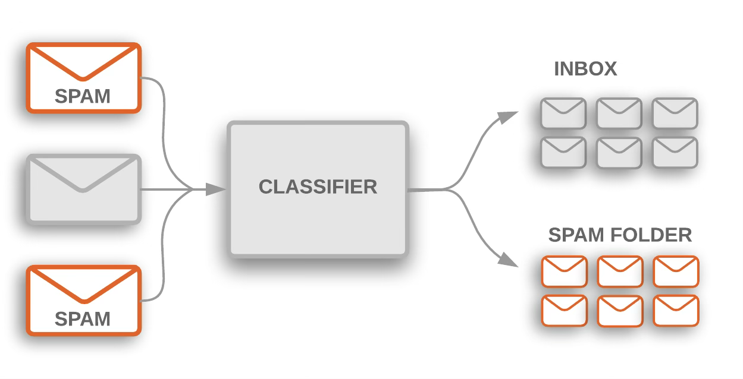
Email Spam Detection
Team Name : AURELIUS

Slide 2
Table of Contents
01
Problem Statement
02
Dataset Details (EDA and Data Visualization)
03
Theoretical Aspects
04
Existing Methods in Spam Email Detection
05
Research Findings
06
Implementation Details
07
Plan to Complete the Project

Slide 3
1
Problem Statement
This project aims to develop an efficient machine-learning model capable of classifying emails as either spam or ham (non-spam). The model will be trained on a labelled dataset of emails, utilizing machine learning algorithms to enhance both classification accuracy and efficiency. This problem statement encompasses several crucial steps, including reading the dataset, preprocessing the data, selecting and training a machine learning model, and finally evaluating the model using performance metrics such as accuracy, precision, recall, and F1 score.

Slide 4
2
Dataset Details (EDA and Data Visualization)

Slide 5
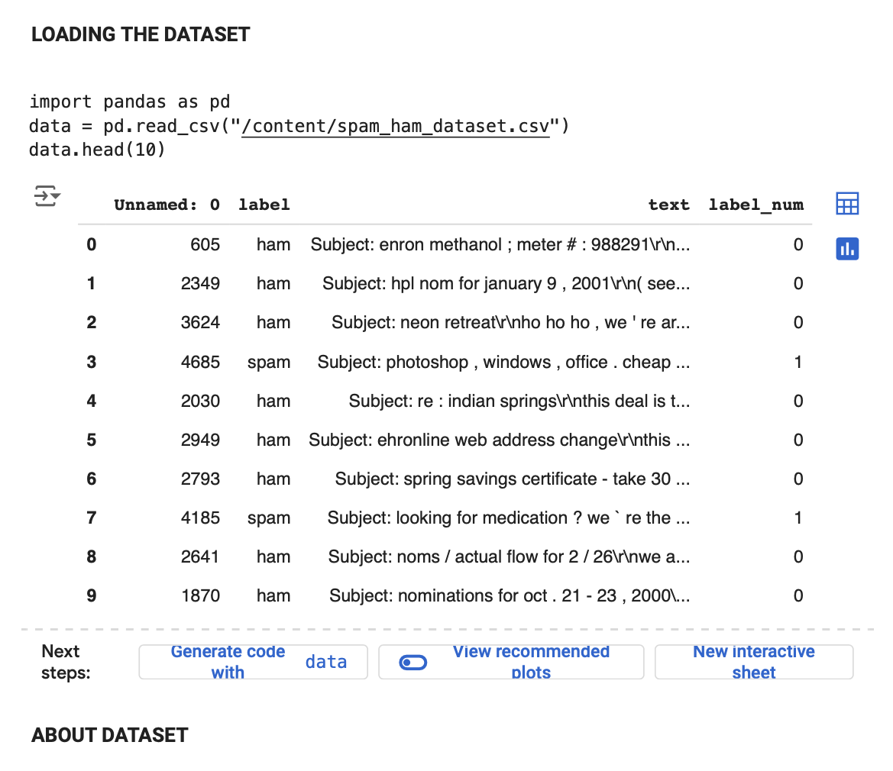

Slide 6
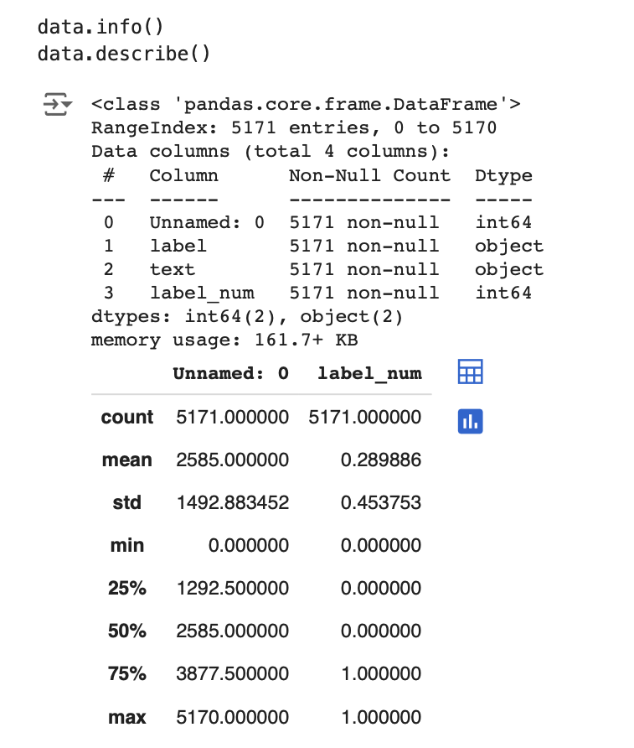

Slide 7
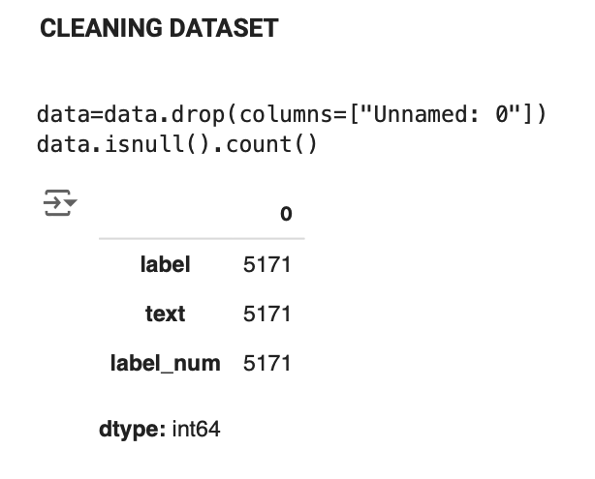

Slide 8
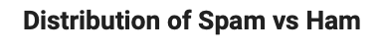
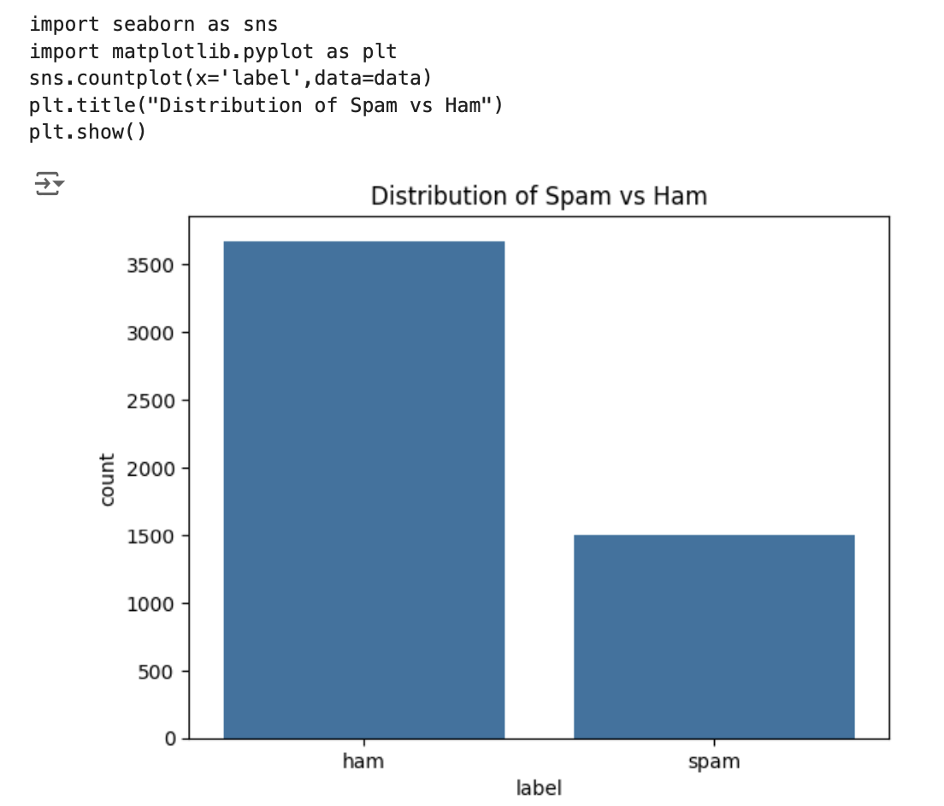

Slide 9
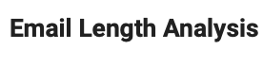
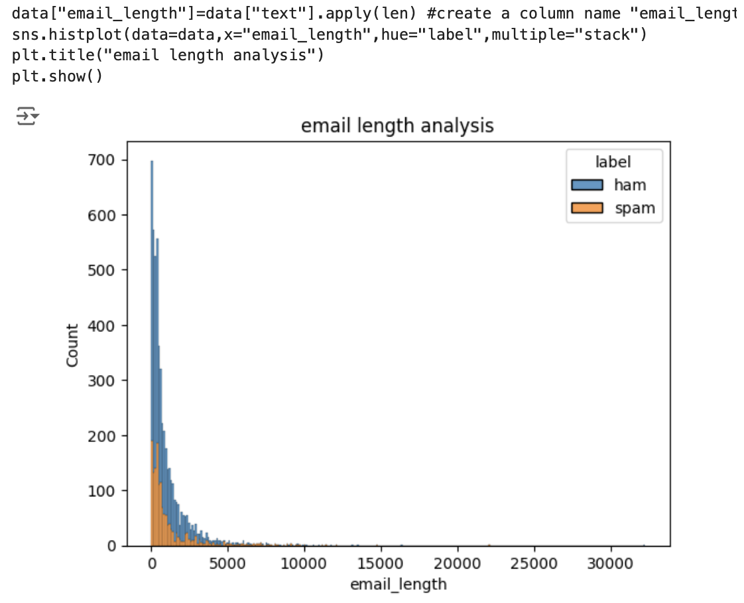

Slide 10
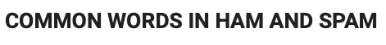
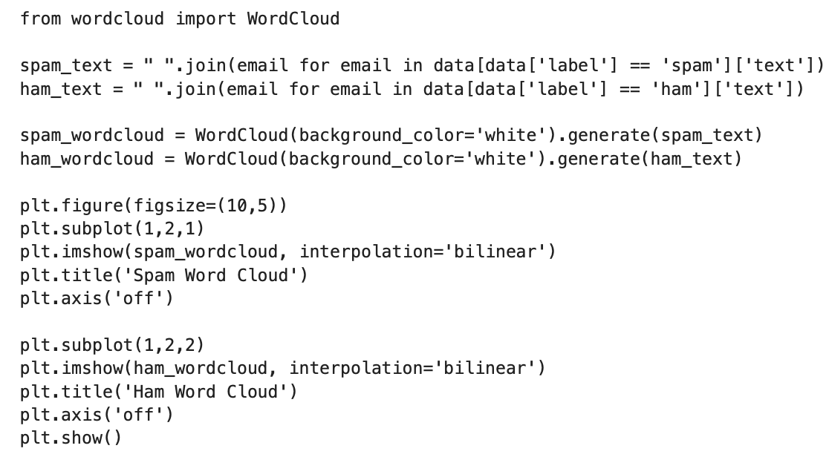

Slide 11
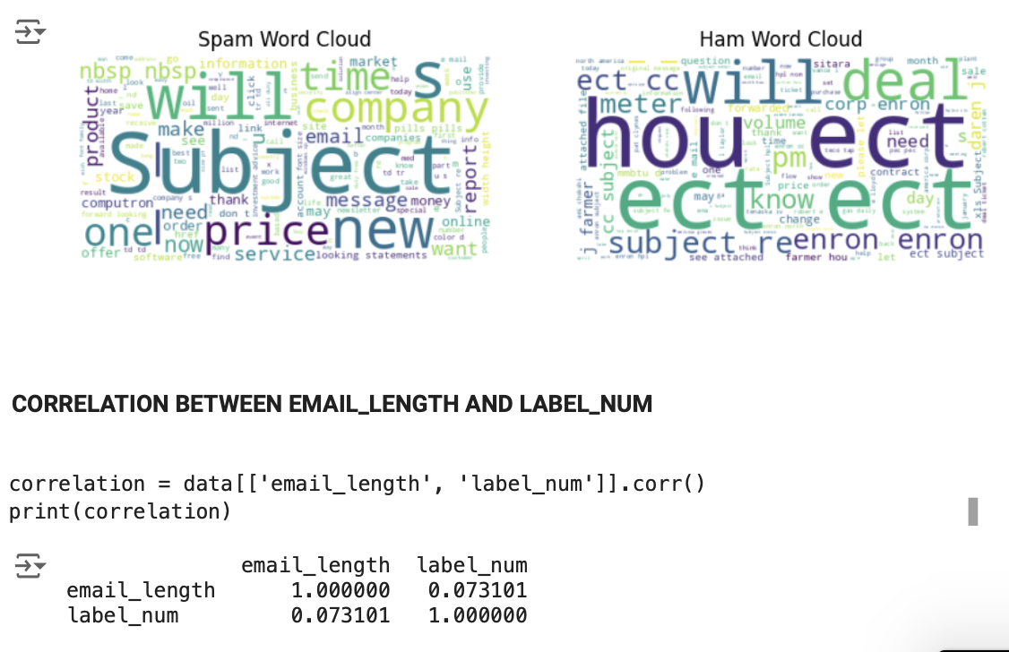

Slide 12
3
Theoretical Aspects
Email spam detection relies on machine learning principles, particularly supervised learning, to sort emails into categories of spam or ham. Various algorithms, such as Naive Bayes and Support Vector Machines, are utilized to analyze the content, employing techniques like Bag of Words (represent text data as a collection of words, disregarding grammar and corresponding order) and TF-IDF (measures the importance of a word in a document relative to a collection of documents) to determine the significance of different words.
Essential elements include feature engineering, which involves extracting meaningful data like word frequencies and sender details, as well as evaluation metrics such as accuracy, precision, and recall measuring how well the model performs. The field also encounters challenges, including evolving spam tactics and issues related to data imbalance. These factors require ongoing updates to the models and raise important ethical considerations regarding privacy and fairness in the classification process.

Slide 13
4
Existing Methods in Spam Email Detection

Slide 14
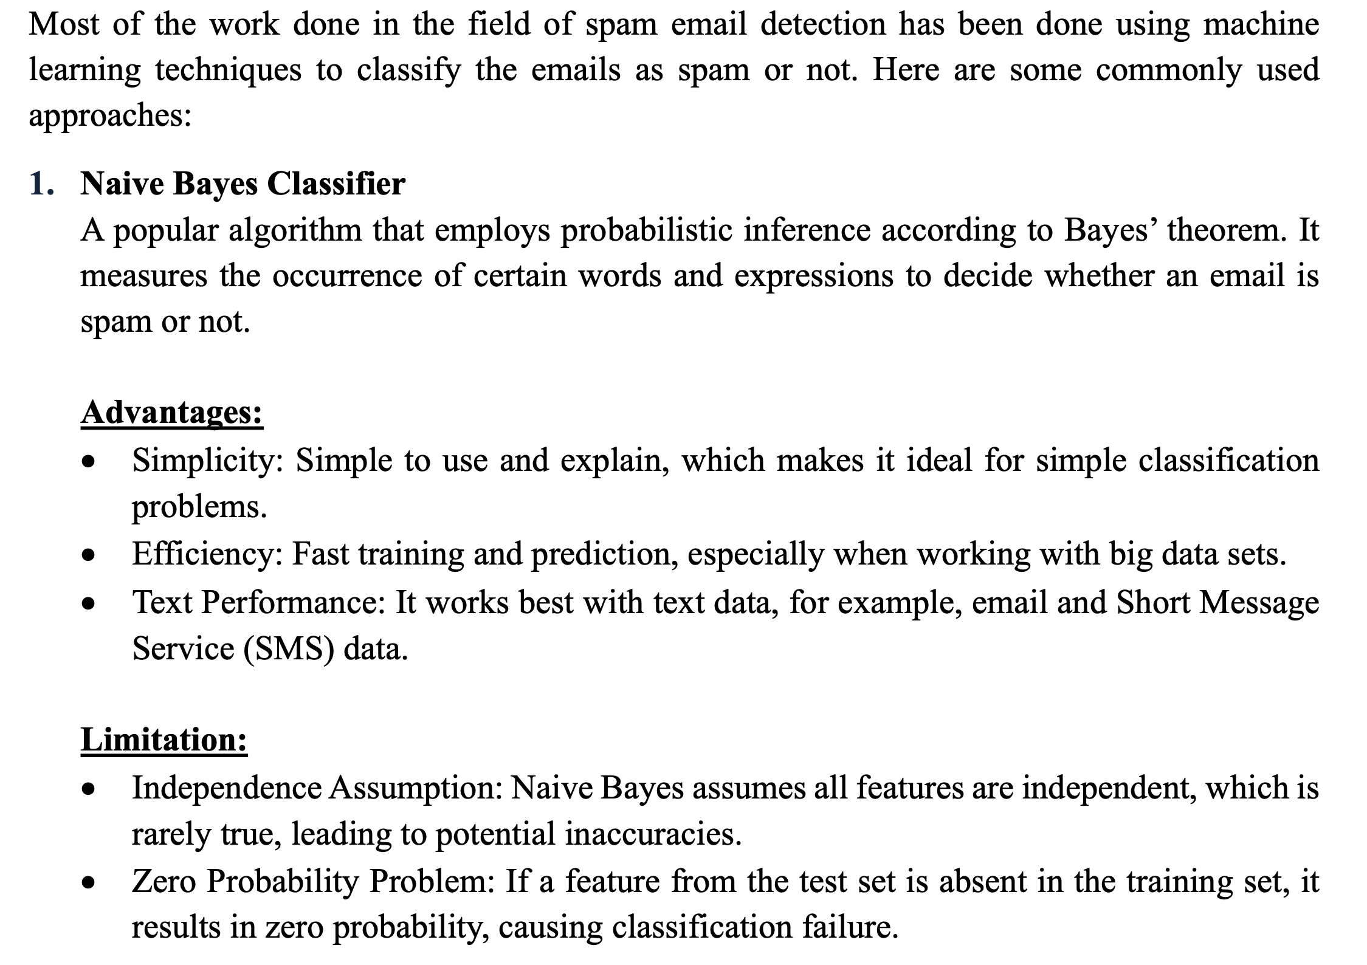

Slide 15
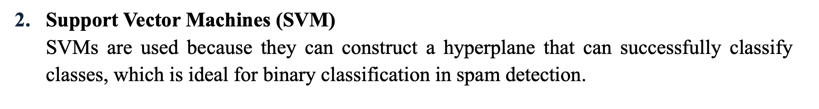
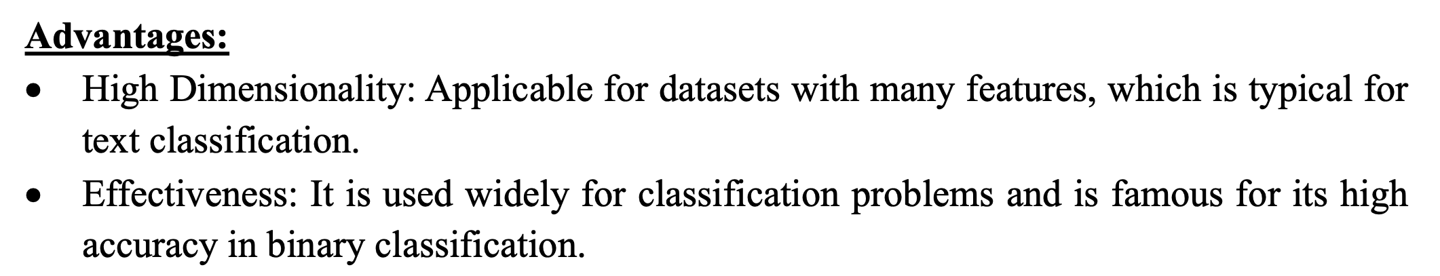
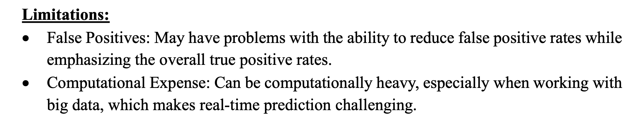

Slide 16
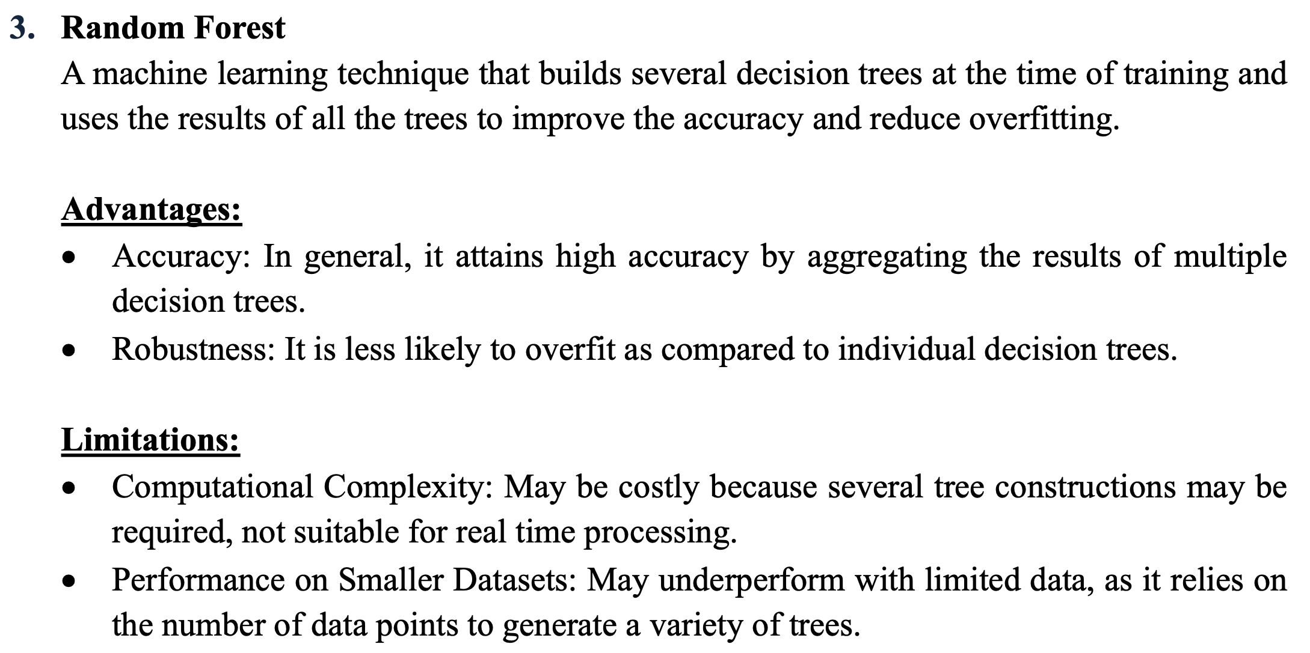

Slide 17
5
Research Finding

Slide 18
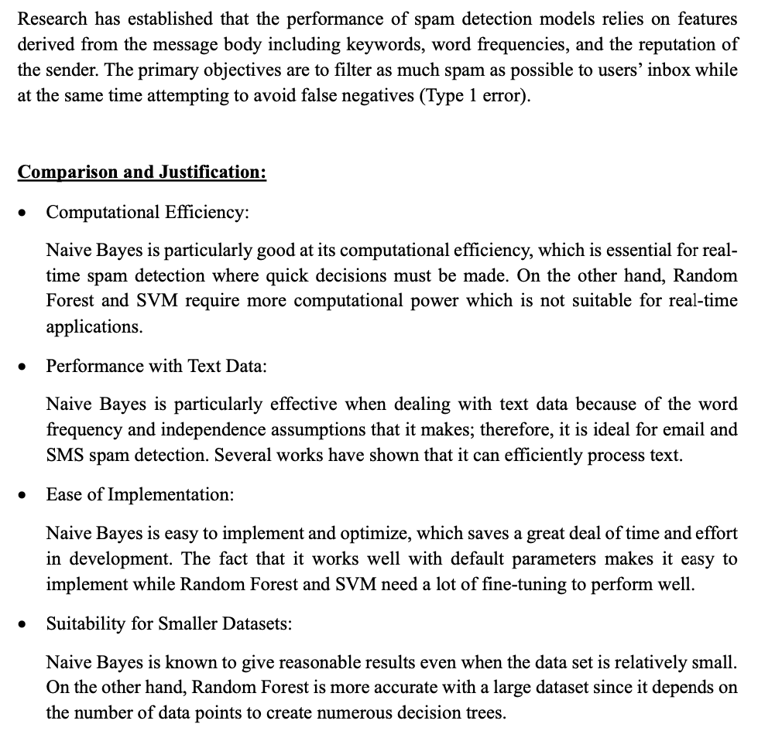

Slide 19
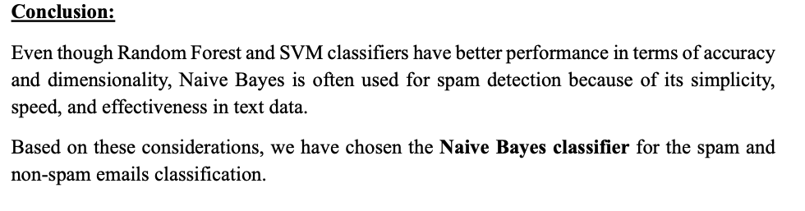

Slide 20
6
Implementation Details

Slide 21
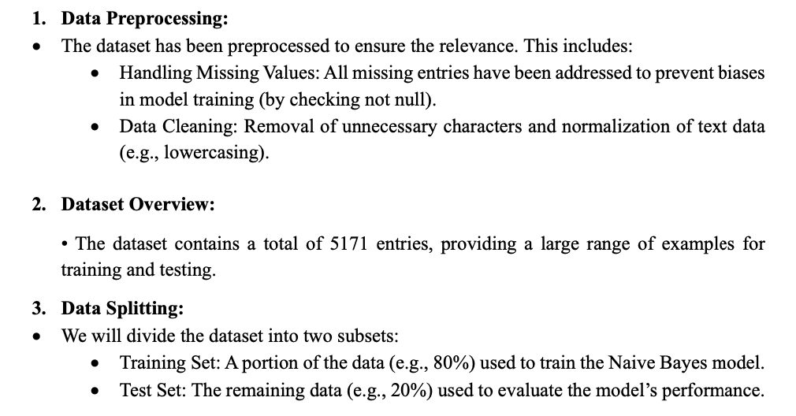

Slide 22
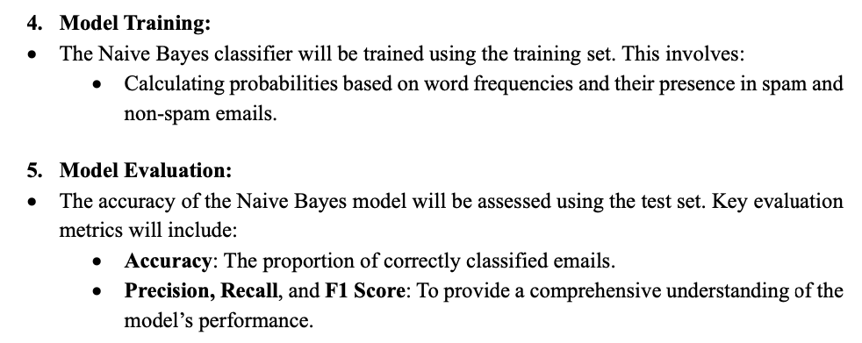

Slide 23
7
Plan to complete the Project

Slide 24
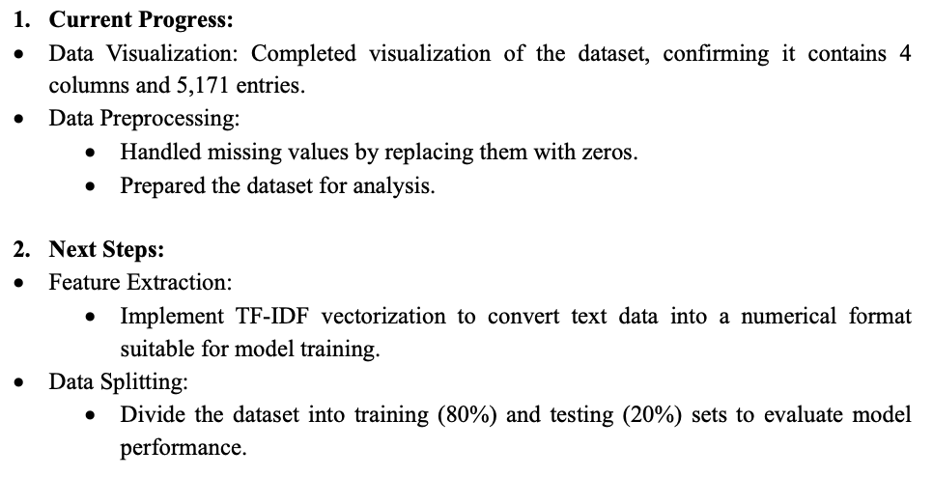

Slide 25
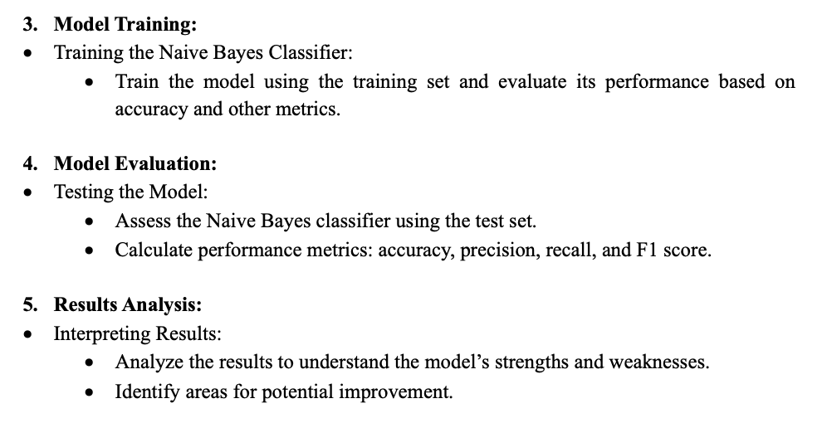

Slide 26
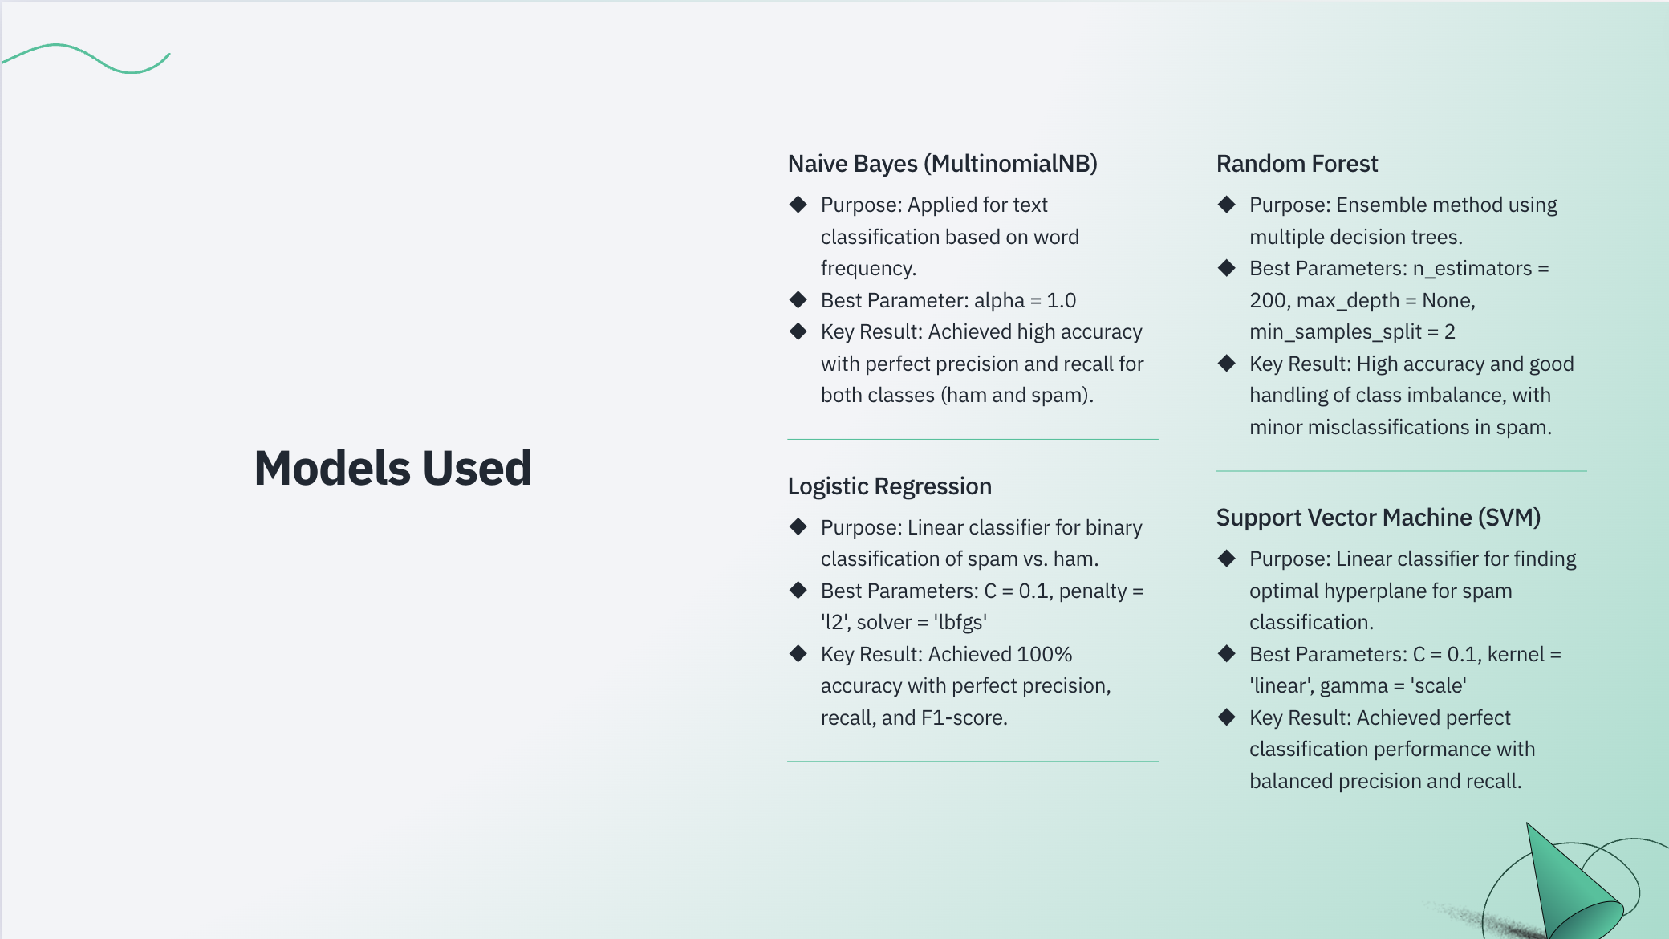

Slide 27


Slide 28
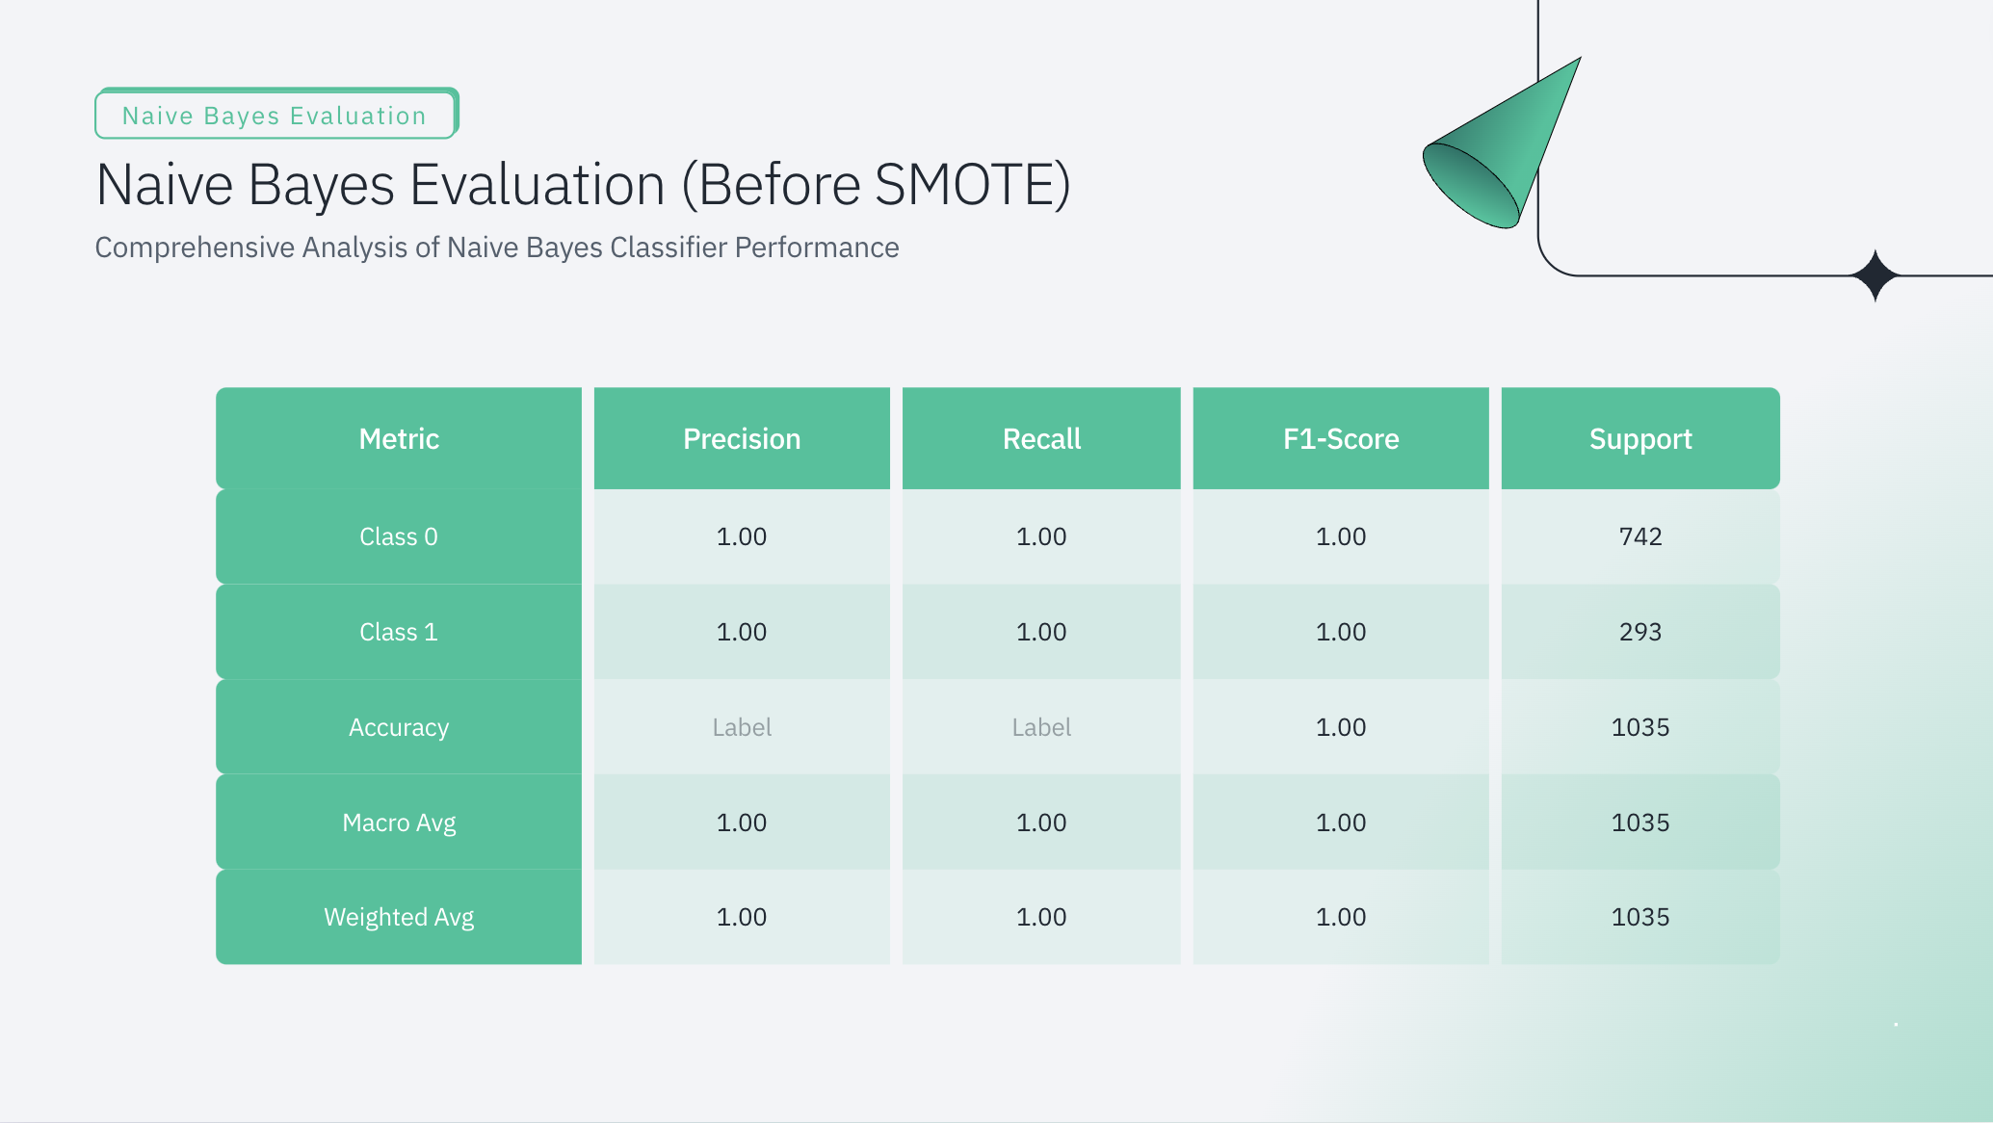

Slide 29
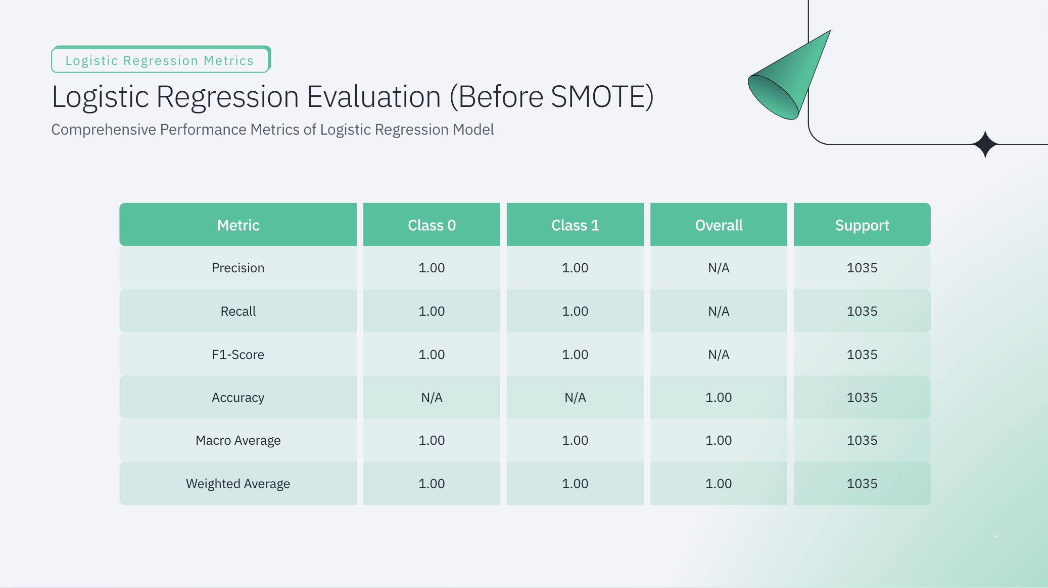

Slide 30
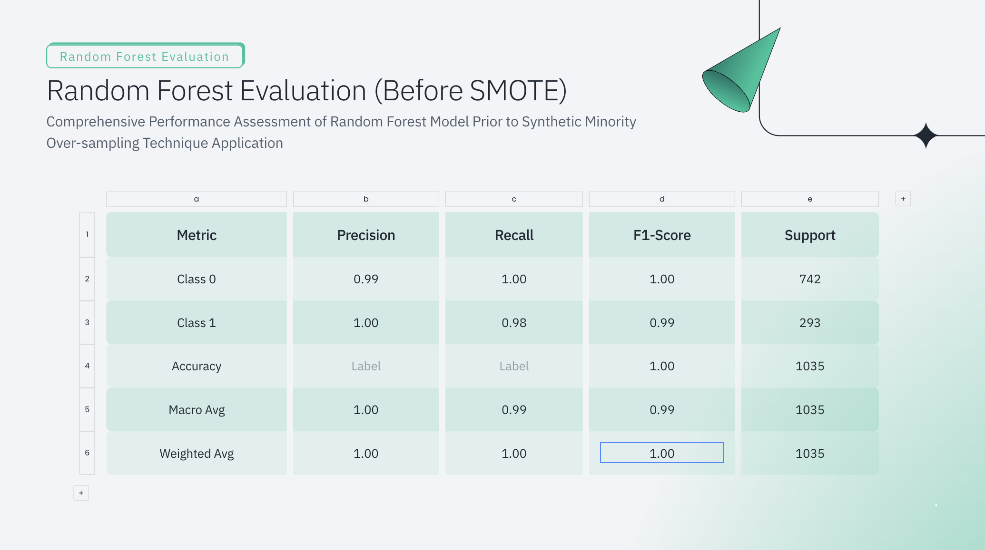

Slide 31
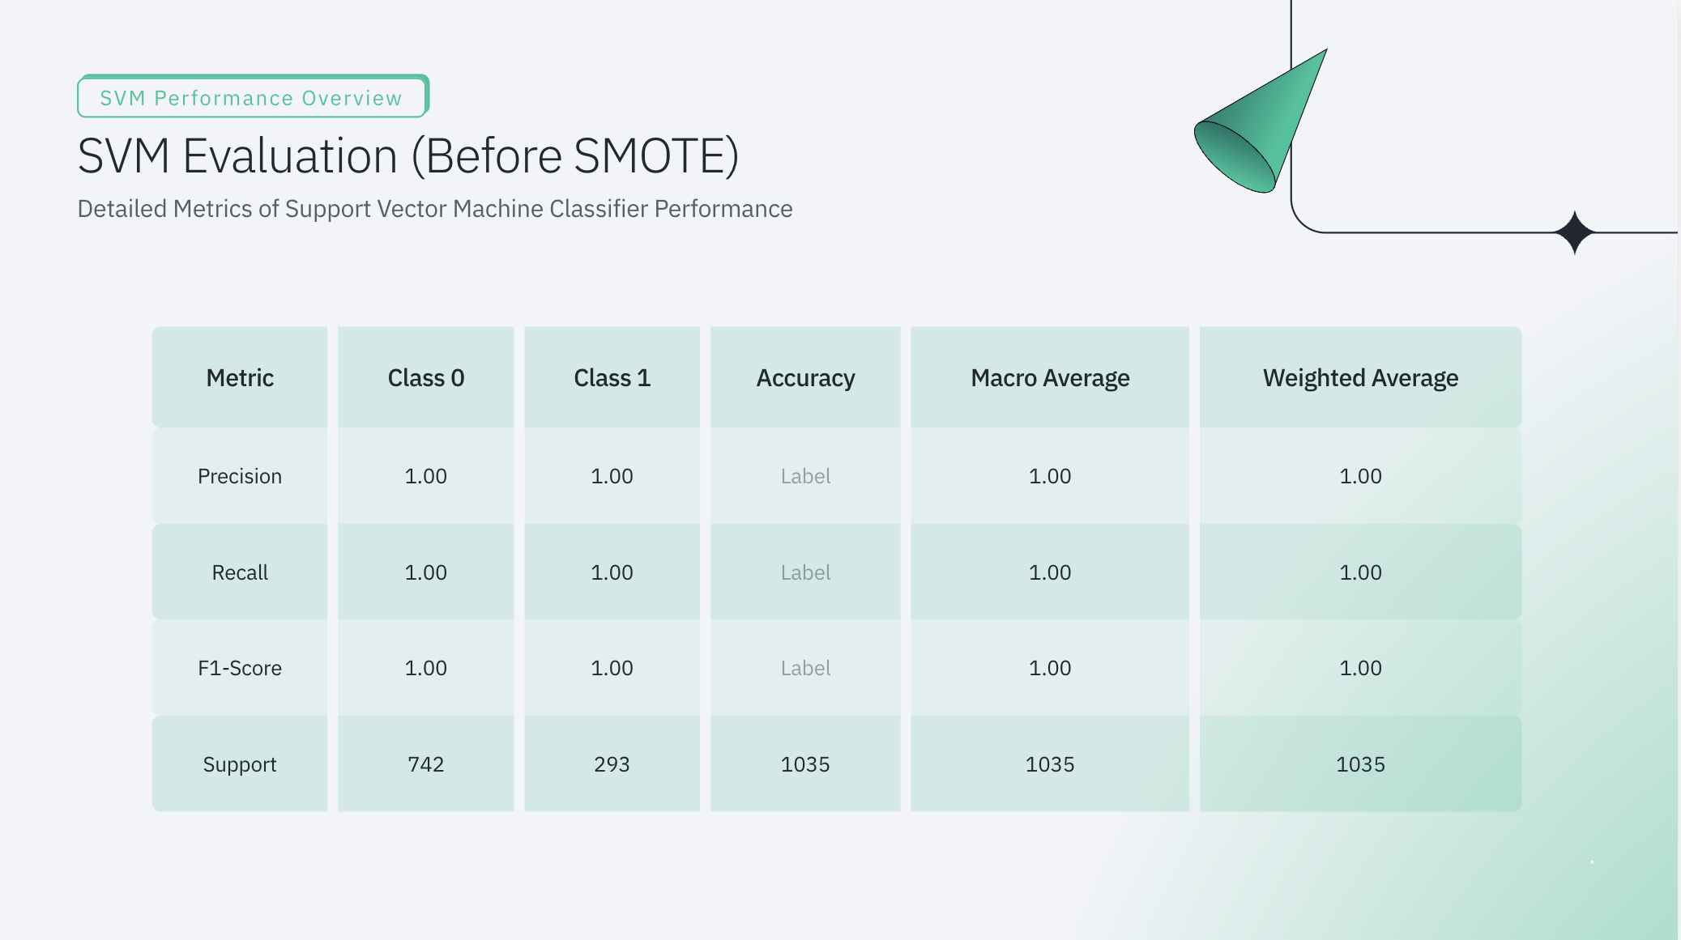

Slide 32
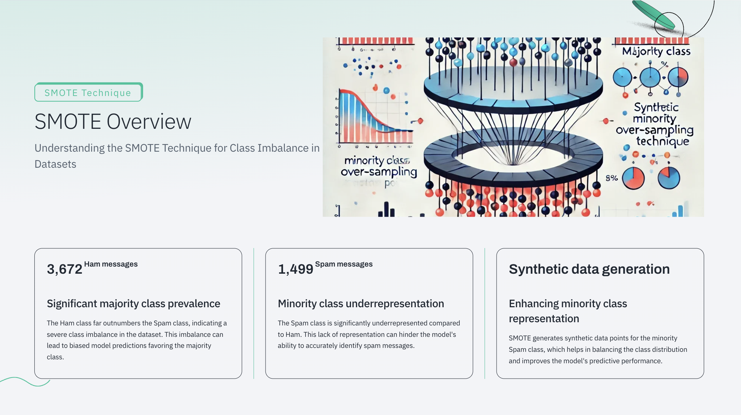

Slide 33
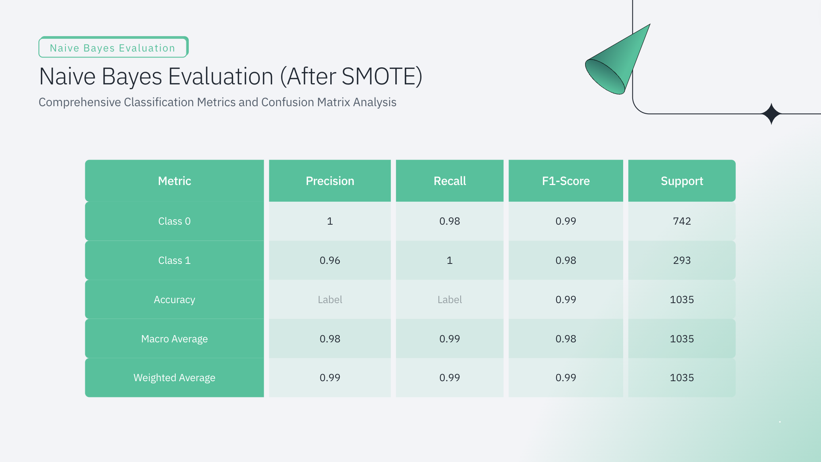

Slide 34
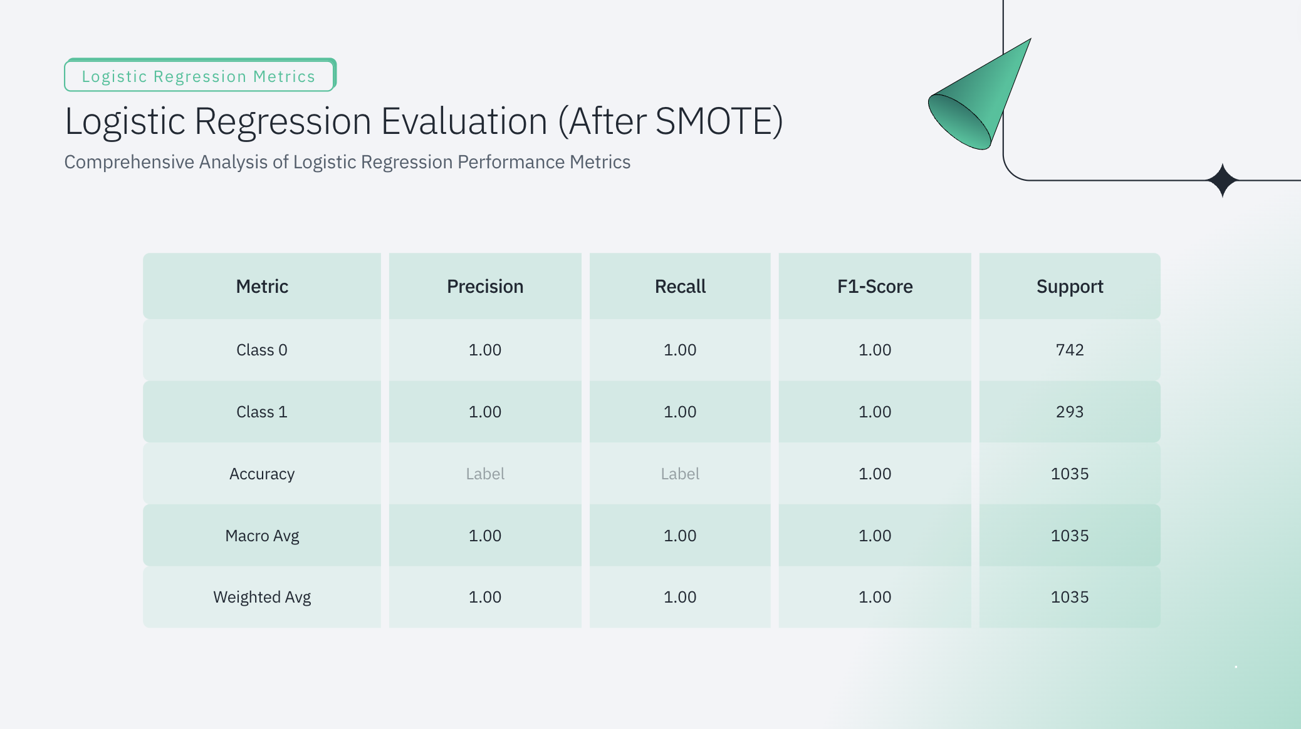

Slide 35
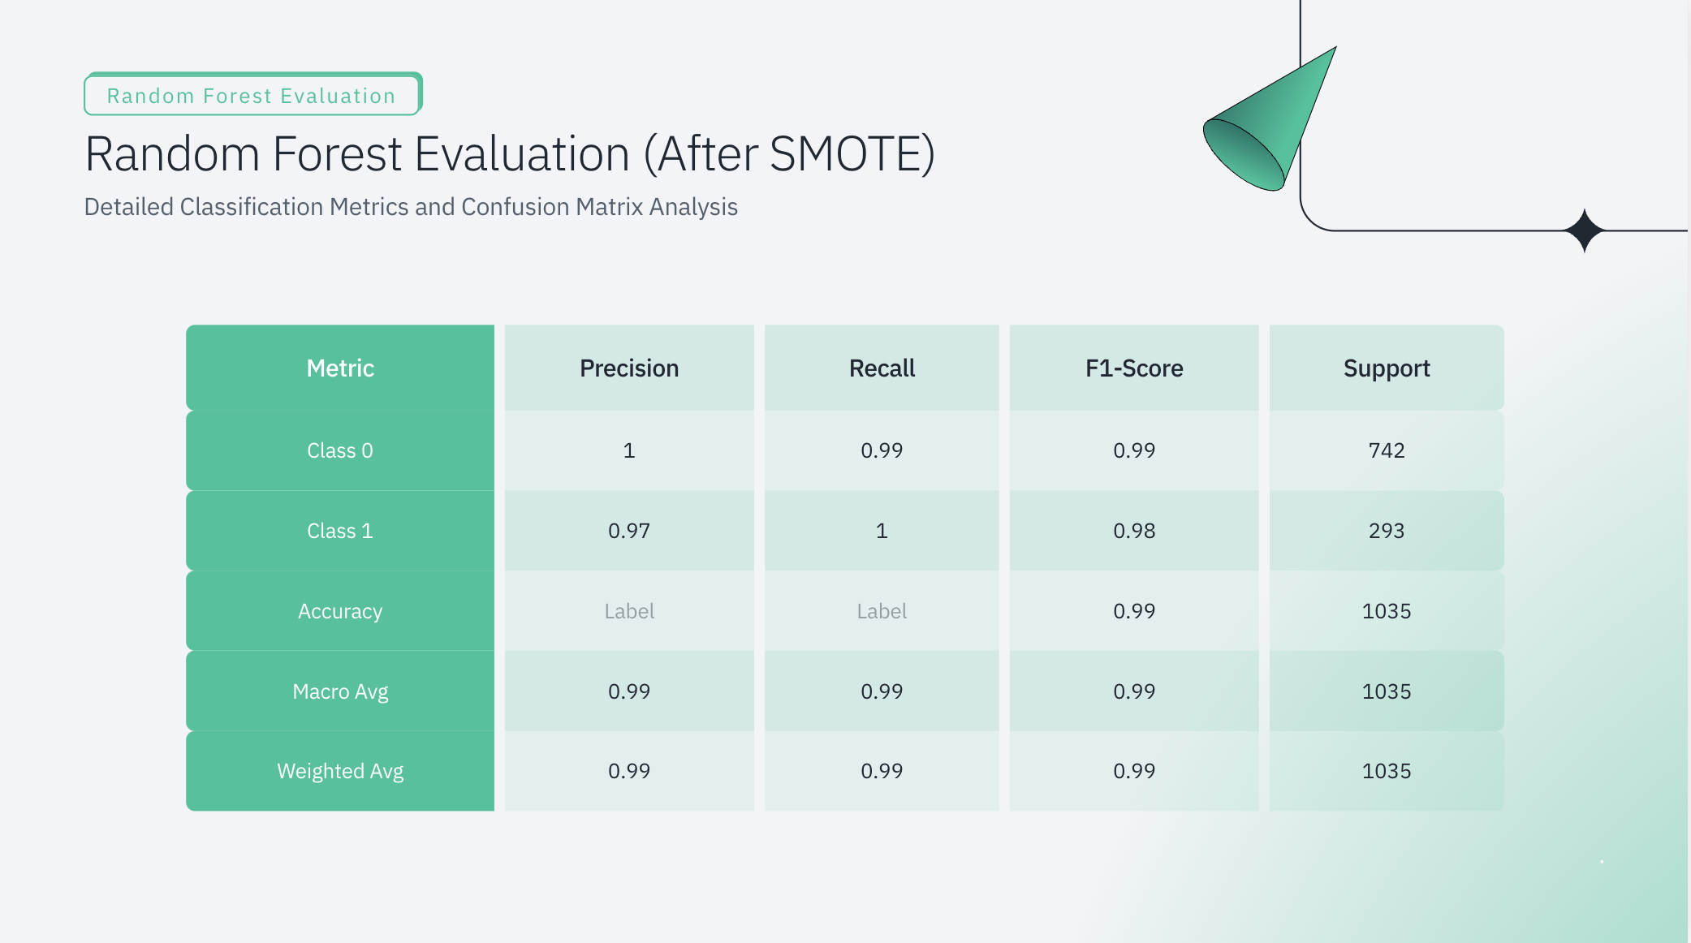

Slide 36
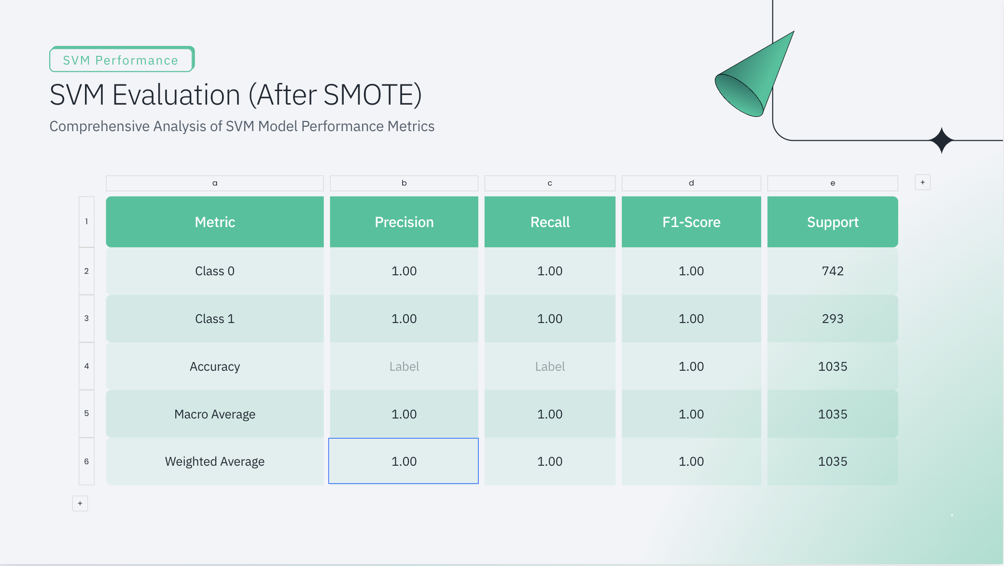

Slide 37
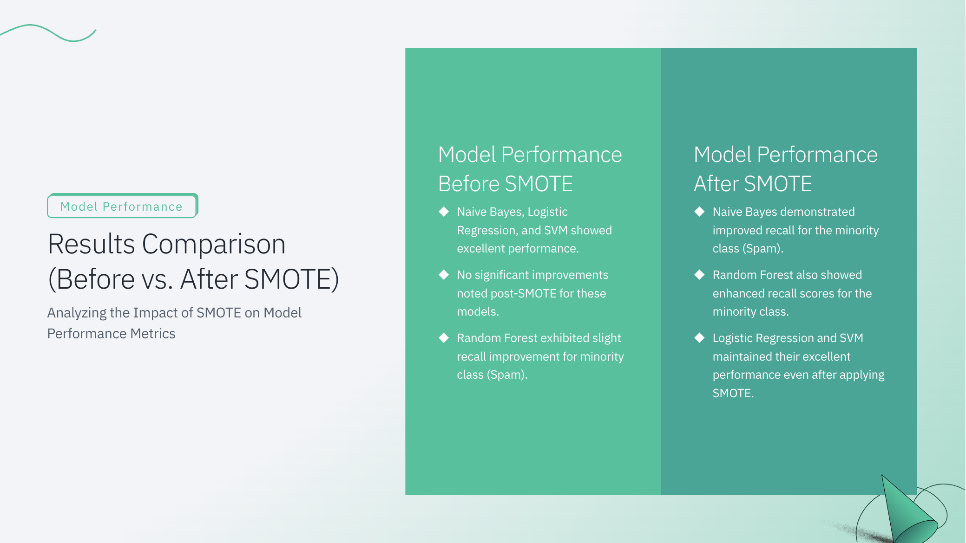

Slide 38
8
Thank You!

